Slide 1
CSE5095-002: Topics in Software Defined Networking
Lecture 12
SDN security
Minmei Wang
Computer Science and Engineering

Slide 2
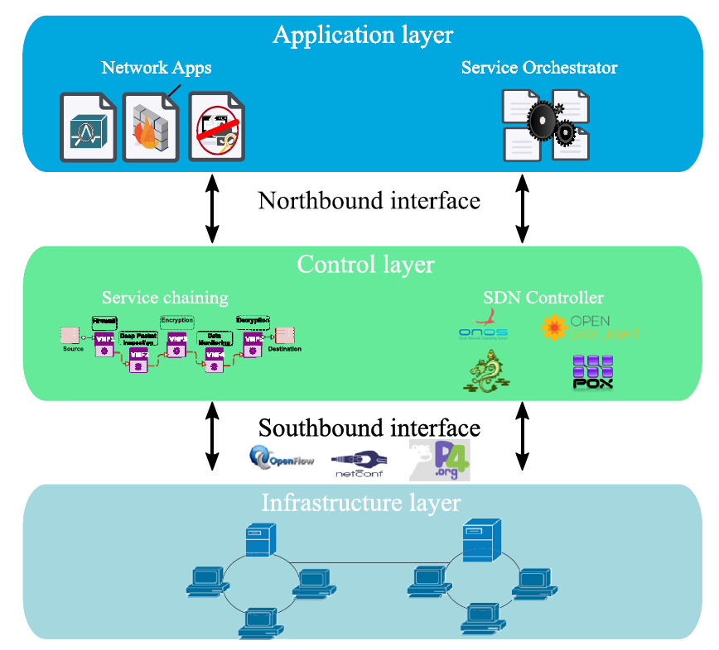
SDN architecture

Slide 3
Attacks to the SDN architecture
Flow Wars: Systemizing the Attack Surface and Defenses in Software-Defined Networks
Changhoon Yoon, Seungsoo Lee, Heedo Kang, Taejune Park, Seungwon Shin, Vinod Yegneswaran, Phillip Porras, Guofei Gu

Slide 4
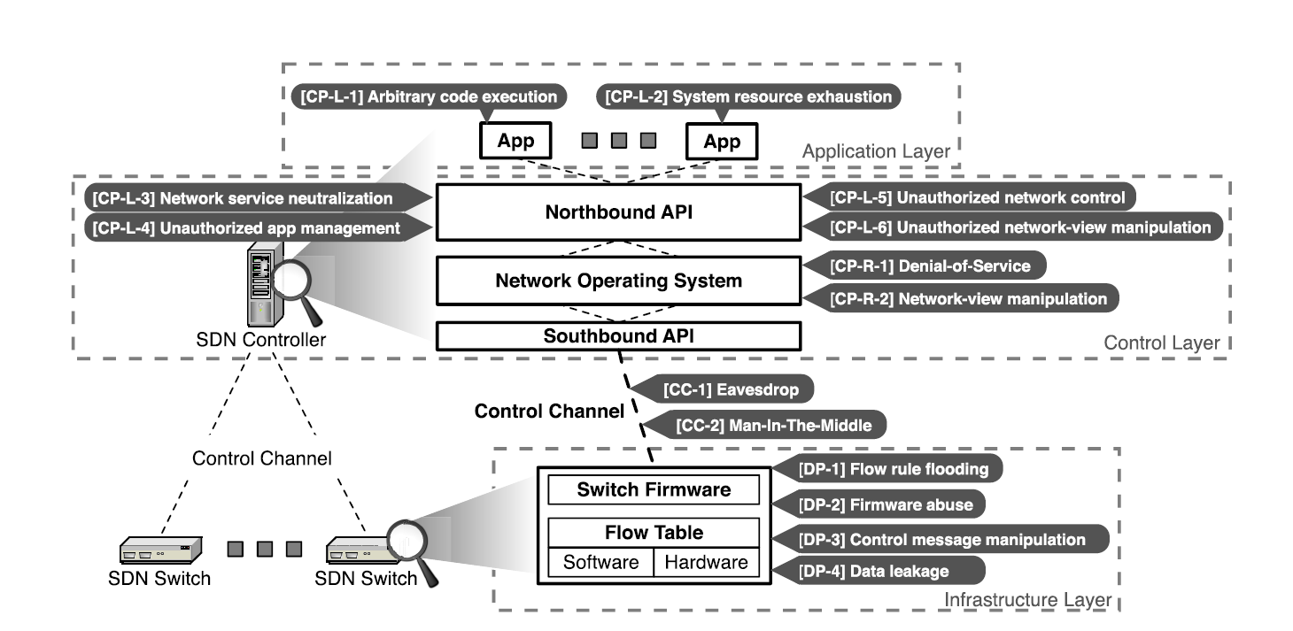
Overview of the SDN attack surface
CP-R: control plane remote attacks
CP-L: control plane local attacks
CC: control channel attacks
DP: data plane attacks

Slide 5
CP-R: Control Plane Remote Attacks
Denial-of-Service (DoS) attacks
SDN controllers
Loss of availability or the instability of the victim network
Network-view manipulation
Controllers implement Host Tracking Services (HTS) and Link Discovery Services (LDS)
Since there are dynamically changing locations of the network nodes and hosts

Slide 6
Denial-of-Service (DoS) attacks
Feasible remote DoS attacks
Packet-in flooding (OpenFlow)
An SDN switch notifies an SDN controller of each unseen flow (or for each flow table mismatch)
Switch table flooding
Fill up the switch table of controller and cause switch disconnections
Floodlight: add one switch table entry when receiving OpenFlow’s features_reply meassage with new DPID values
Use up all the memory resource available in the controller

Slide 7
Denial-of-Service (DoS) attacks
Feasible remote DoS attacks
Switch identification spoofing
Modify the OpenFlow control message to spoof its identity as if it is the target switch
DPID and the name of a switch are used to distinguish between switch devices
Attackers use DPID and the name of a switch to build a connection, disconnecting the connection with the compromised switch (legitimate switch)
Malformed control message injection
Attackers modifies the message length field of the OpenFlow header to an incorrect value
SDN controllers (e.g., POX and Floodlight) disconnect the switches that sent such malformed messages

Slide 8
Denial-of-Service (DoS) attacks
Feasible remote DoS attacks
System time manipulation
SDN controllers and applications refer to system variables for various purposes (e.g., FloodLight and OpenDaylight)
System time variables for carrying out time-sensitive tasks
Calculate packet timeouts
Modify time variables may cause disconnection between switches and controllers

Slide 9
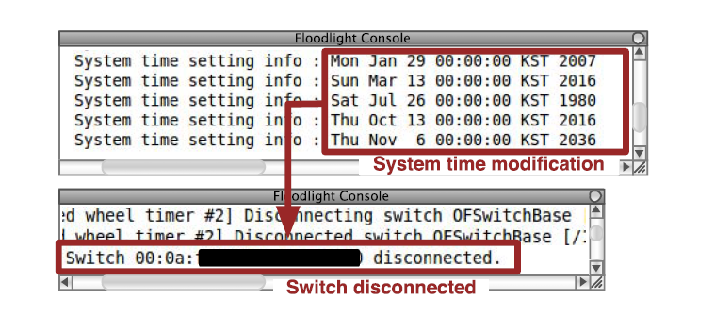
Denial-of-Service (DoS) attacks
System time modification causing switch disconnection
This attack does not affect POX because this controller does not refer to the system time

Slide 10
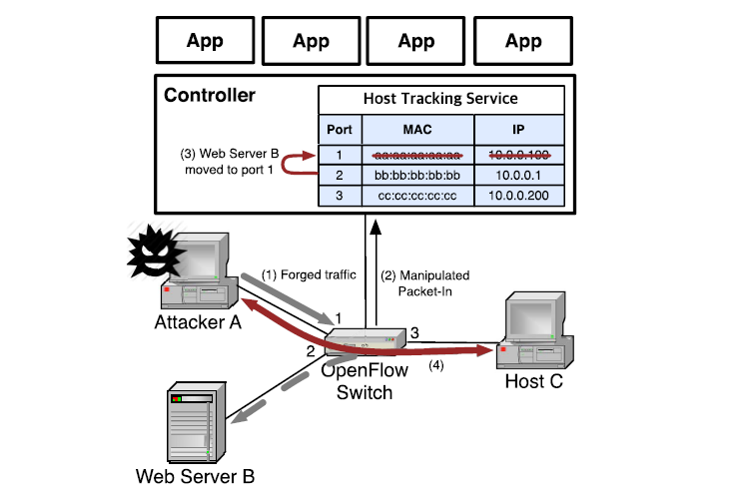
Network-view manipulation
Topology poisoning attack
Deceive the HTS of controllers
Forge some network packets
Most HTS implementations only use simple identifiers to distinguish among the hosts
Attacker A spoof packets to have the source MAC and IP of Web Server B
A sends packet_in based on manipulated traffic information
HTS believes that Web Server B has migrated and newly linked to port 1

Slide 11
Overview of the SDN attack surface
CP-R: control plane remote attacks
CP-L: control plane local attacks
CC: control channel attacks
DP: data plane attacks

Slide 12
CP-L: Control Plane Local Attacks
Arbitrary system termination
A system call misuse scenario is possible since most SDN controllers are designed to run SDN applications within the controller instance
An SDN application invokes the system exit command
Terminate the application & controller instance
Loss of the control plane is undesirable
System resource exhaustion
SDN controller implementations are end-host user-level applications
The performance is limited by the capabilities of the hosting machine
It is possible to consume the system resources of the hosting machine
A simple SDN application

Slide 13
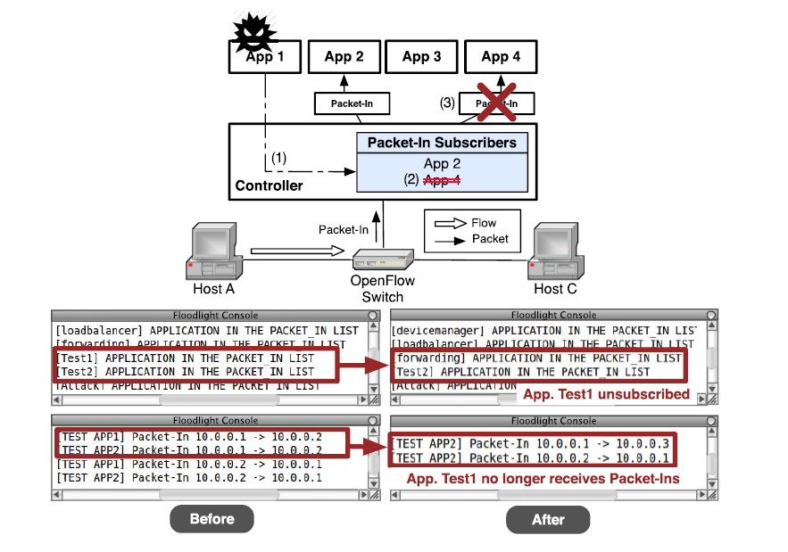
CP-L: Control Plane Local Attacks
Network service neutralization
Control message delivery obstruction
Packet-in unsubscription: different applications subscribe newly generated control events

Slide 14
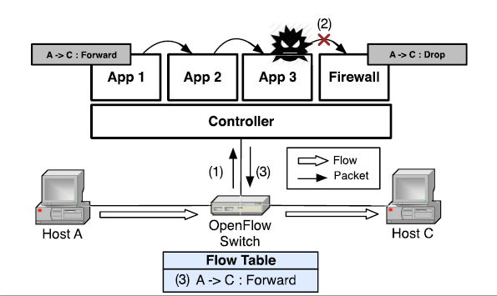
CP-L: Control Plane Local Attacks
Network service neutralization
Control message delivery obstruction
API misuse
Service chain jamming
Intentional insertion of infinite loops into the application
Service chain

Slide 15
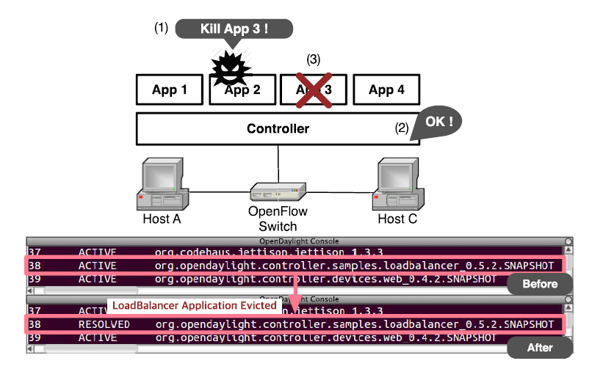
CP-L: Control Plane Local Attacks
Unauthorized application management
An SDN application can misuse Northbound APIs to evict other legitimate applications
A malicious SDN application may legitimately call the function to terminate other application via Northbound API.
OpenDaylight

Slide 16
CP-L: Control Plane Local Attacks
Unauthorized network control
packet_in control message notifies an SDN controller of a newly incoming network flow
Other types of control messages support various operations
It’s possible to manipulate the control plane by abusing those messages
Examples
Flow-Rule modification

Slide 17
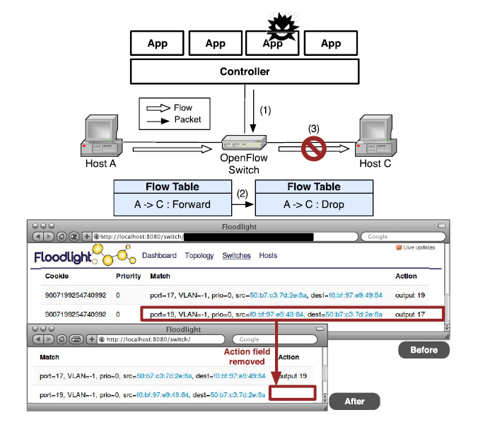
CP-L: Control Plane Local Attacks

Slide 18
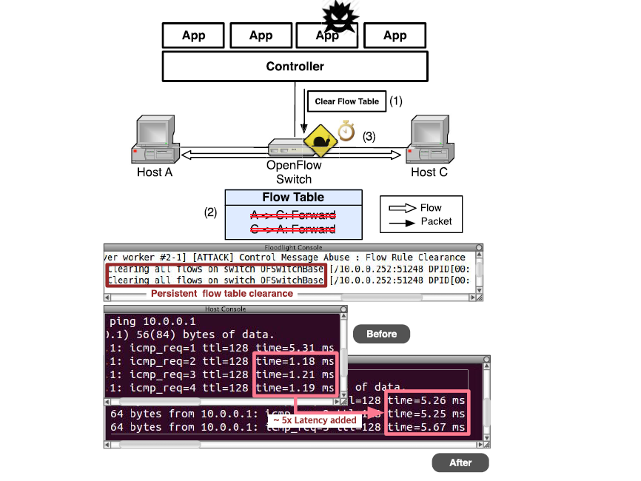
CP-L: Control Plane Local Attacks
Examples
Flow table flushing
It causes flow entry mismatch for all incoming network flows.
cause the flow entry mismatch
degrade the network performance

Slide 19
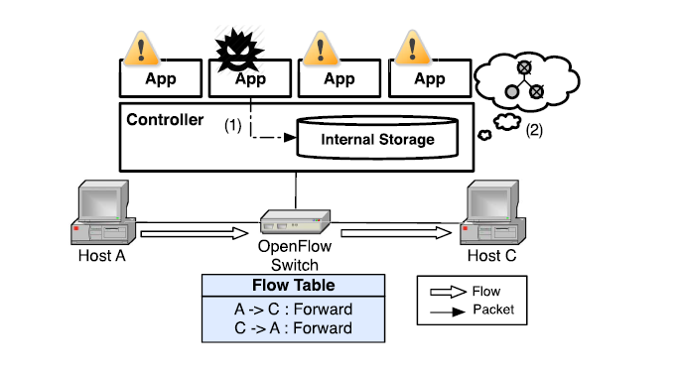
CP-L: Control Plane Local Attacks
Unauthorized network-view manipulation
SDN controllers implement a shared internal database for storage and management of network information
No restricted access or modifications to the internal storage
Internal data storage modification

Slide 20
Overview of the SDN attack surface
CP-R: control plane remote attacks
CP-L: control plane local attacks
CC: control channel attacks
DP: data plane attacks

Slide 21
CC: Control Channel Attacks
Eavesdropping
Encrypted channel (e.g., SSL/TLS protocol) is not widely adopted
Attackers can sniff the ongoing OpenFlow messages
Exfiltrate the topology information of the managed network
Man-in-the-Middle

Slide 22
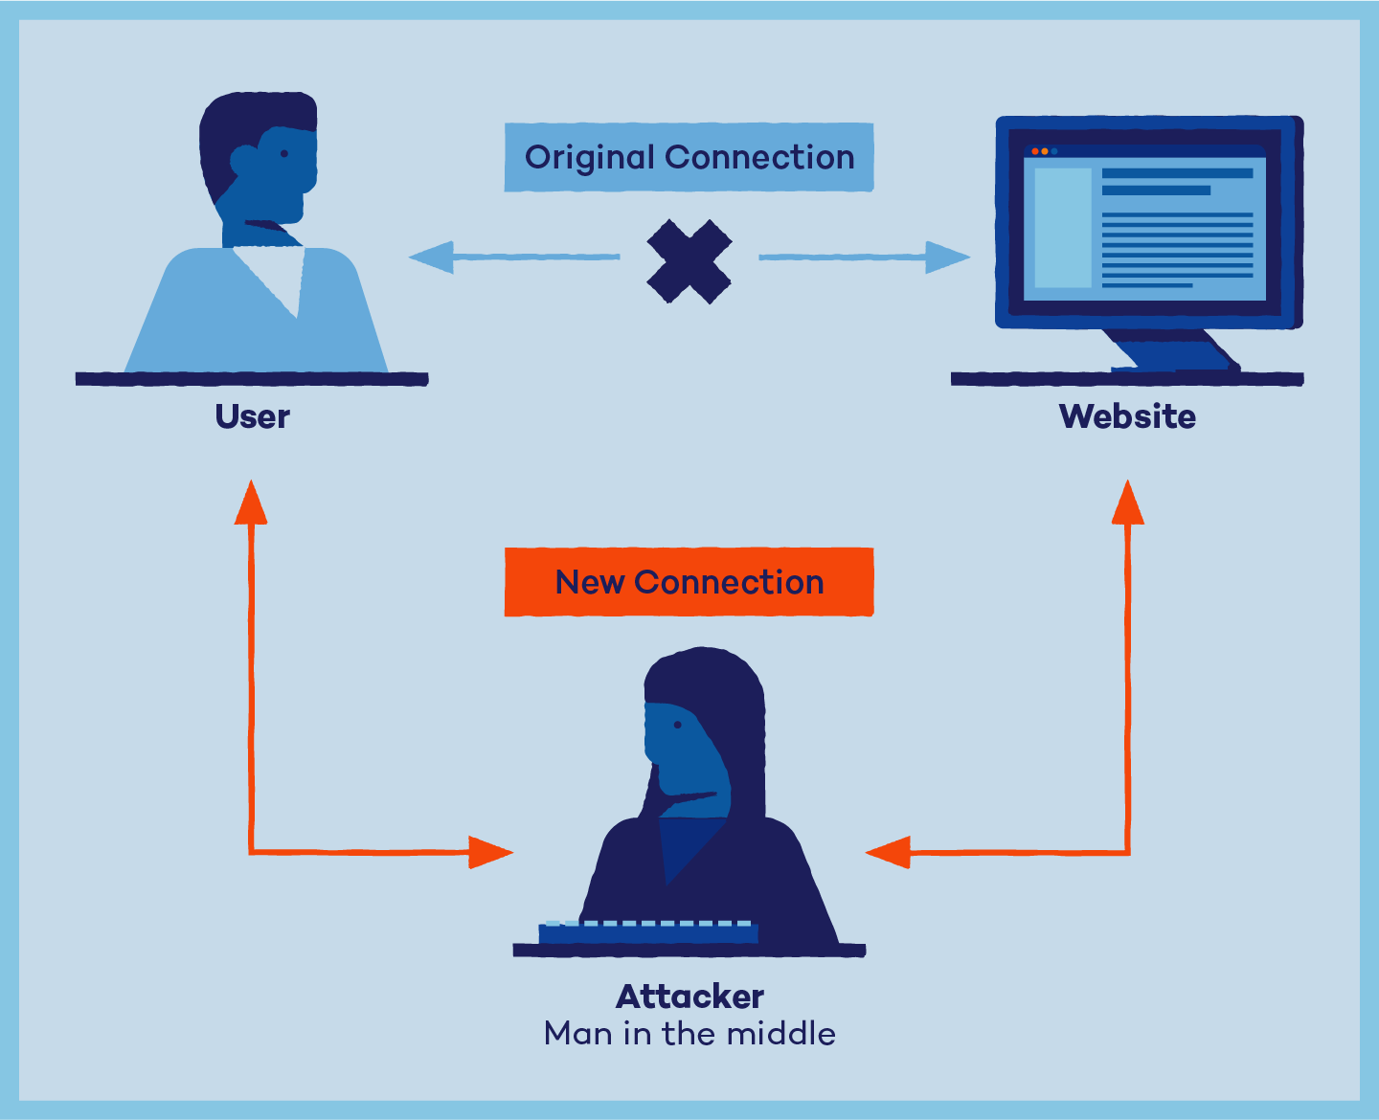
Man-in-the-Middle

Slide 23
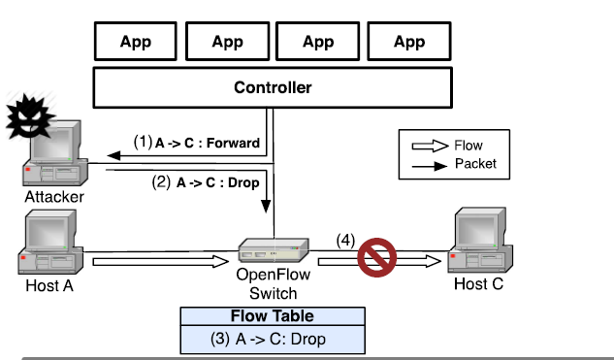
CC: Control Channel Attacks
Eavesdropping
Encrypted channel (e.g., SSL/TLS protocol) is not widely adopted
Attackers can sniff the ongoing OpenFlow messages
Exfiltrate the topology information of the managed network
Man-in-the-Middle

Slide 24
Overview of the SDN attack surface
CP-R: control plane remote attacks
CP-L: control plane local attacks
CC: control channel attacks
DP: data plane attacks

Slide 25
DP: Data Plane Attacks
Flow rule flooding
No restriction on issuing control messages
An SDN application can issue any control message at any time
A malicious application continuously generates flow rules
Fill up the flow table of the switch
The switch cannot handle more rules
Switch firmware abuse
A malicious application install flow rules that need to be processed in a software table
Network performance degradation

Slide 26
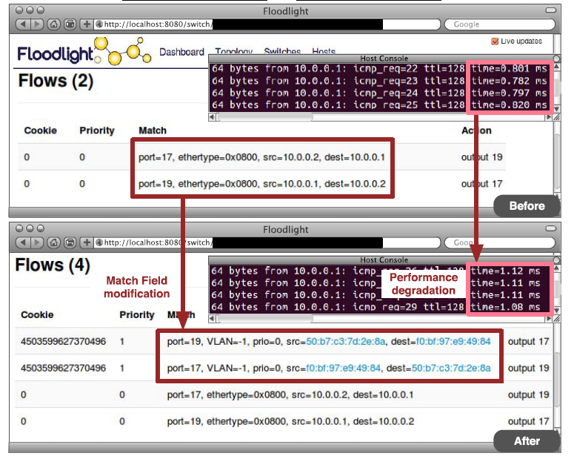
DP: Data Plane Attacks
Switch firmware abuse

Slide 27
DP: Data Plane Attacks
Malformed control message injection
Manipulated control messages may be sent to the data plane
Cause switch to end up in an unpredictable state
SDN controllers (e.g., POX and Floodlight) disconnect the switches that sent such malformed messages
Data leakage
OpenFlow-enabled switches query SDN controllers for each flow table miss
Infer sensitive information by measuring RTT
J. Sonchack, A. Dubey, A. J. Aviv, J. M. Smith, and E. Keller, “Timing based
reconnaissance and defense in software-defined networks.

Slide 28
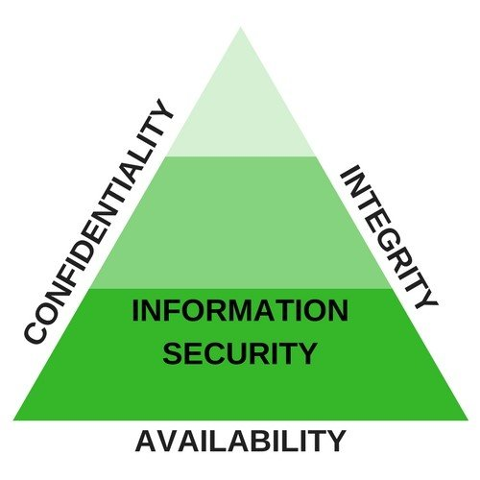
CIA Triad
Integrity: data is not tampered with or degraded during or after submission.
Confidentiality: data is only available to authorized parties.
Availability: data is available to authorized users when it is needed.

Slide 29
Control Plane Security
Lack of authorization (confidentiality)
Applications can easily execute sensitive commands
Solution
Introduce a security extension to only grant minimum required permissions to applications based on the security policy
Weak authentication (integrity)
Attackers can modify the messages
Solution
New security extension to provide enhance network element authentication

Slide 30
Control Plane Security
Dependence on external variable (integrity)
System time variable
Can be modified, untrusted
Architectural bottleneck (availability)
Single point of failure of a centralized SDN controller
Solution
Improve the scalability of the control plane
Distributed SDN controller architecture
Monolithic controller design (availability)
SDN controller implementation are monolithic software applications
E.g., java applications running in a JVM with SDN applications
System command execution and resource exhaustion attacks
Use micro-kernel architecture (different address space with kernel)

Slide 31
Control Plane Security
Lack of resource management
Resource exhaustion attacks
Different core modules and SDN applications share system resources
Solution
A resource monitor to dynamically monitor and constrain the resource usage
Improper exception handling
E.g., manipulated control messages cause unexpected behaviors at the SDN controllers

Slide 32
Control Plane Security
Naïve service chaining mechanism
Attackers modify the service chaining
Solution
Verify SDN applications

Slide 33
Control Channel Security
Confidentiality and integrity
SSL/TLS protection is heavy and incurs noticeable performance penalty
A lightweight and reliable encryption mechanism is required
Availability
Attacks affect southbound OpenFlow communications
Detection and verification system to defend the attacks

Slide 34
Data Plane Security
Architectural bottleneck
E.g., switches receive many flow entries
Hardware abuse
Limited capacity of the TCAM table
The switch firmware restricts the use of the hardware table

Slide 35
Application layer security
Applications implement security functions

Slide 36
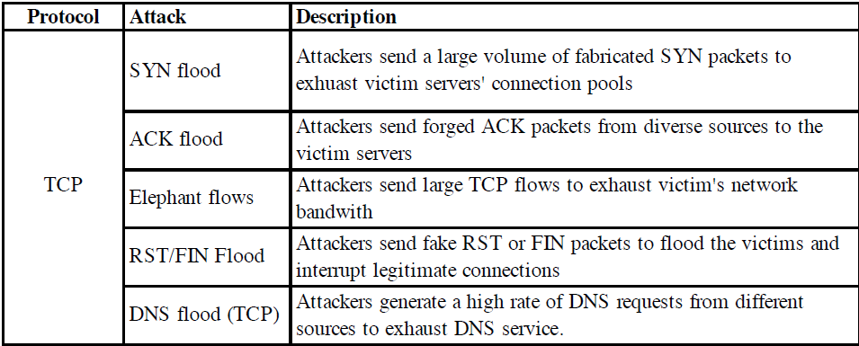
DDoS attacks
Distributed denial of service attacks

Slide 37
Protocols
Network Time Protocol (NTP) is a networking protocol for clock synchronization.
Simple Network Management Protocol (SNMP) is an Internet Standard protocol for collecting and organizing information about managed devices on IP networks.
Simple Service Discovery Protocol (SSDP) is a network protocol based on the Internet protocol suite for advertisement and discovery of network services and presence information.
QUIC is a new multiplexed transport built on top of UDP, designed by Google. The goal is to reduce the latency compared to that of TCP.
Memcached is an in-memory key-value store for small chunks of arbitrary data

Slide 38
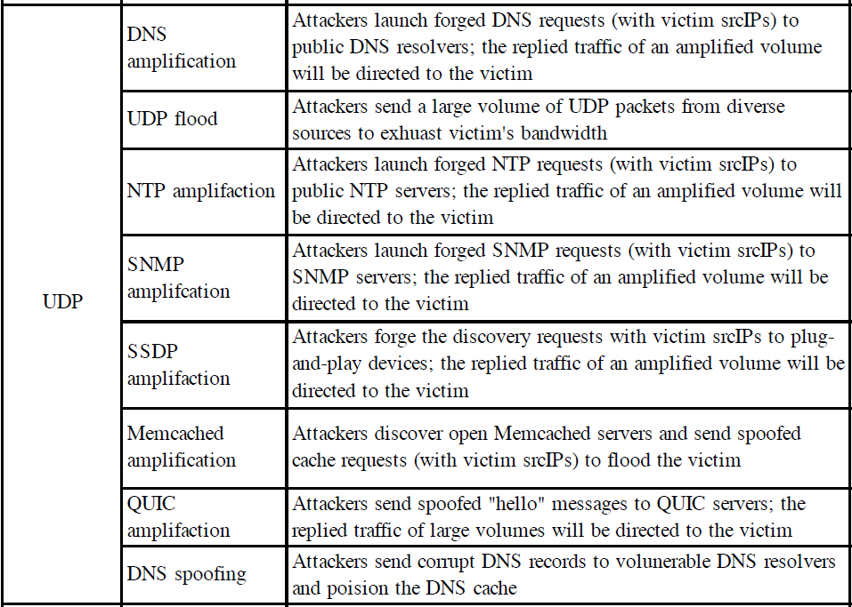

Slide 39
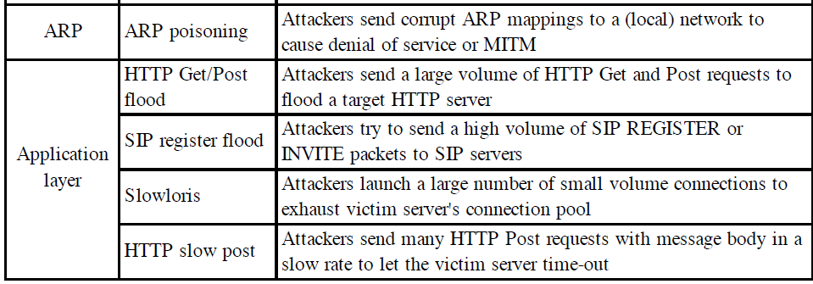
Launch partial HTTP requests
The Session Initiation Protocol (SIP) is a signaling protocol used for initiating, maintaining, and terminating communication sessions that include voice, video and messaging applications.

Slide 40
Midterm materials stop here

